Slide 1
Defect Configurations

Slide 2
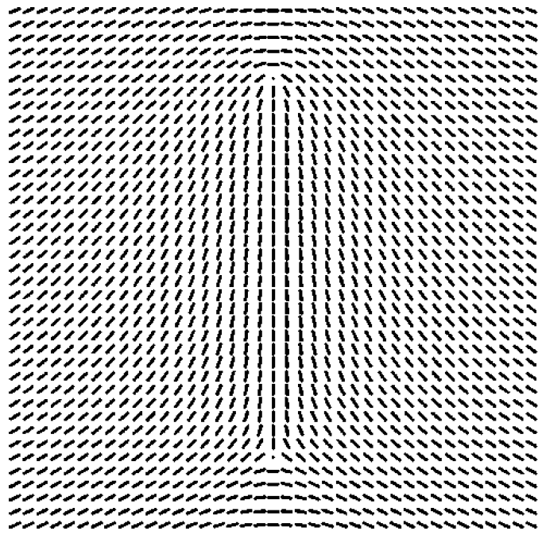
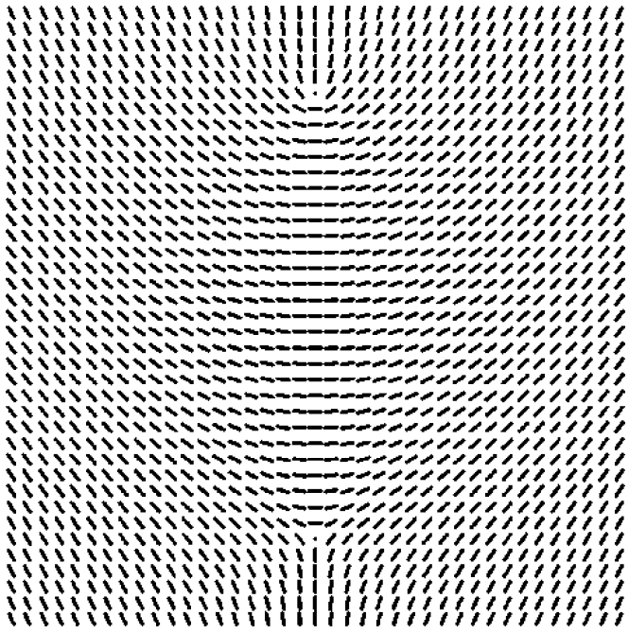
Configuration (a): pretty sure they used this configuration to generate their flow plots
Configuration (b): this is the configuration that I used

Slide 3
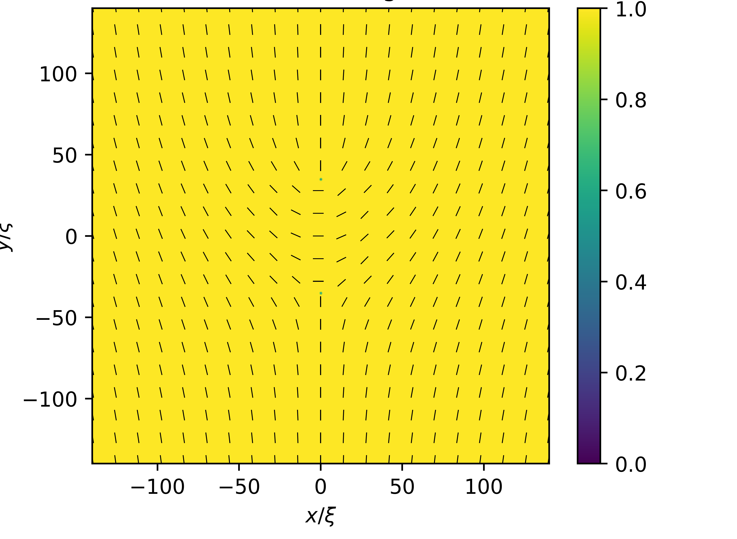

Slide 4
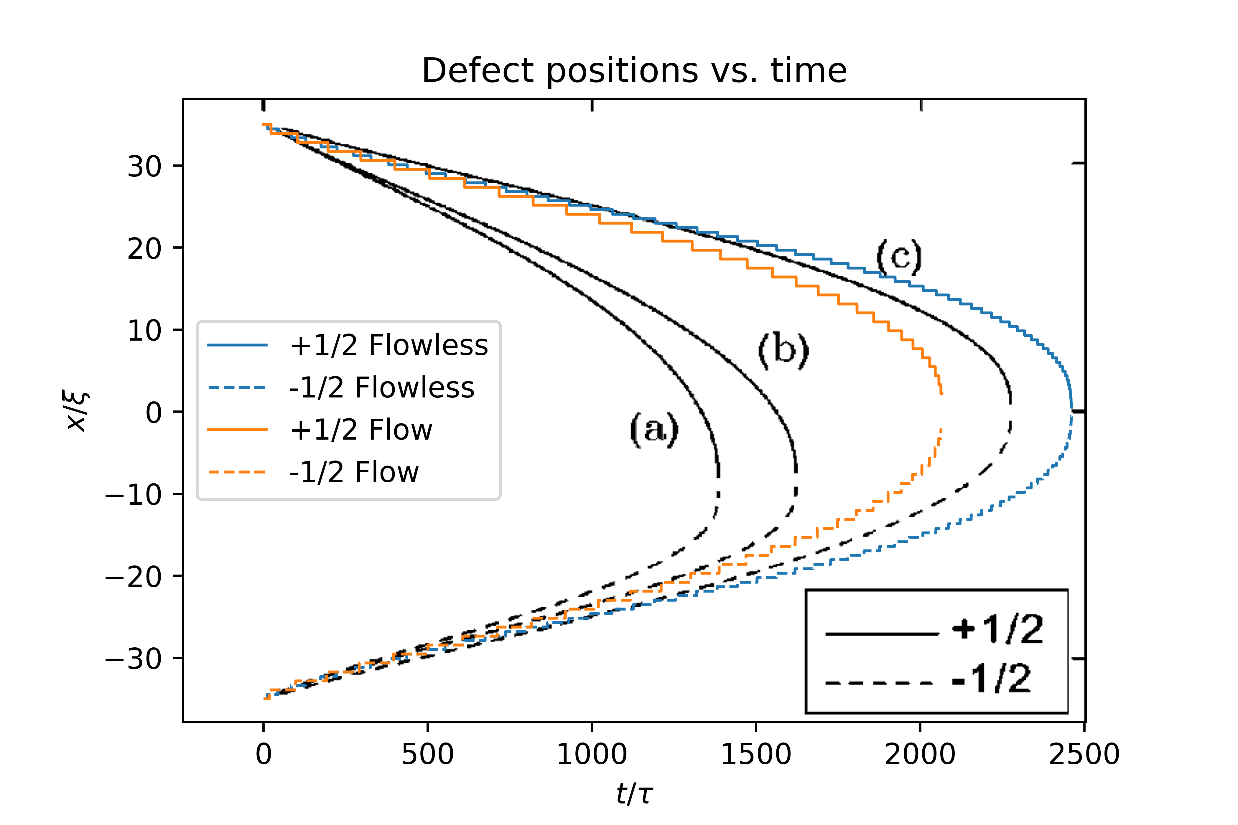
Notes:
My simulation was done with 70 correlation length starting distance between defects, and a 1/4 ratio between defect distance and domain size. Zumer had 3/20 ratio between defect distance and domain size.

Slide 5
257x257 Grid

Slide 6
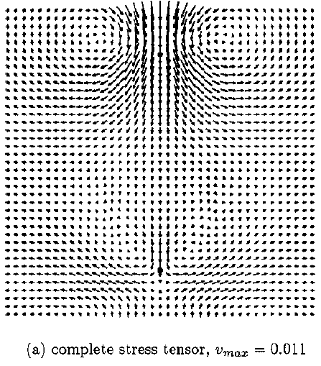
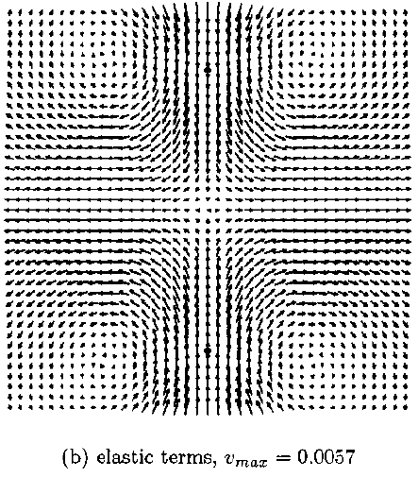
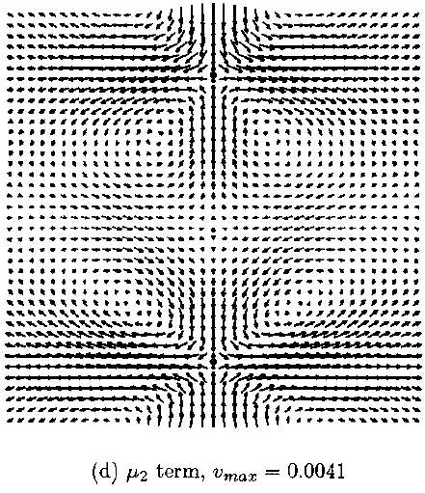
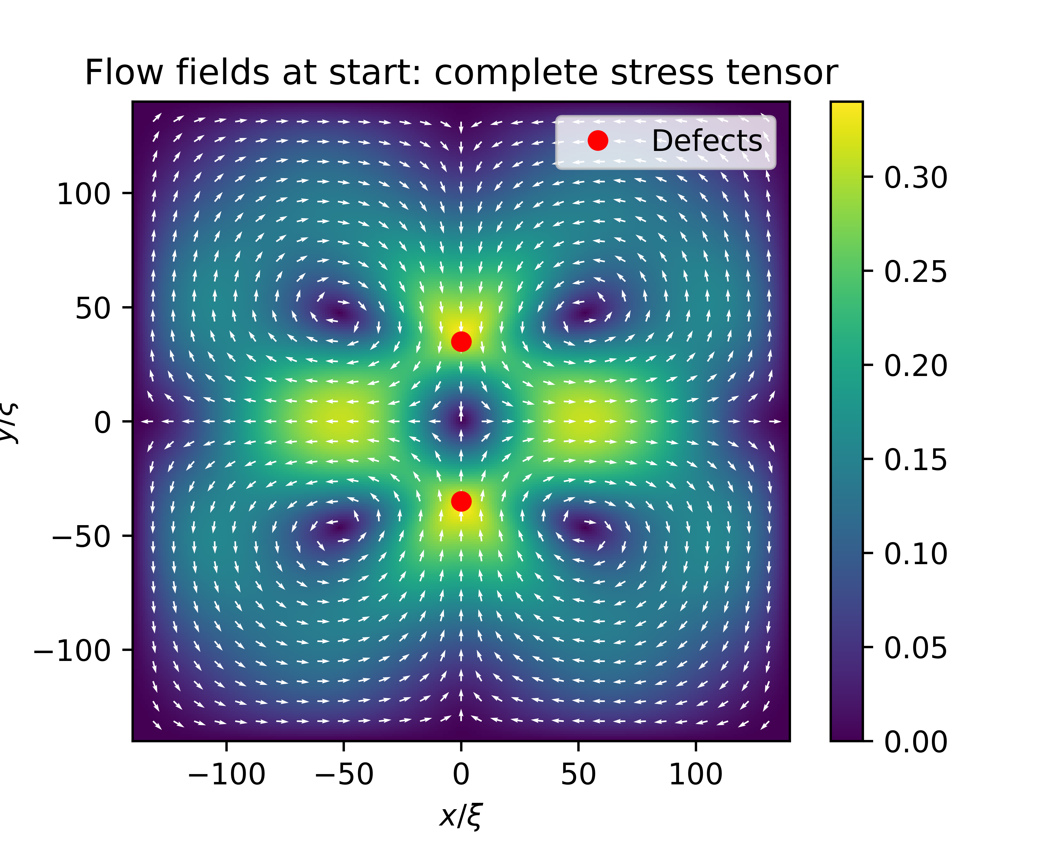
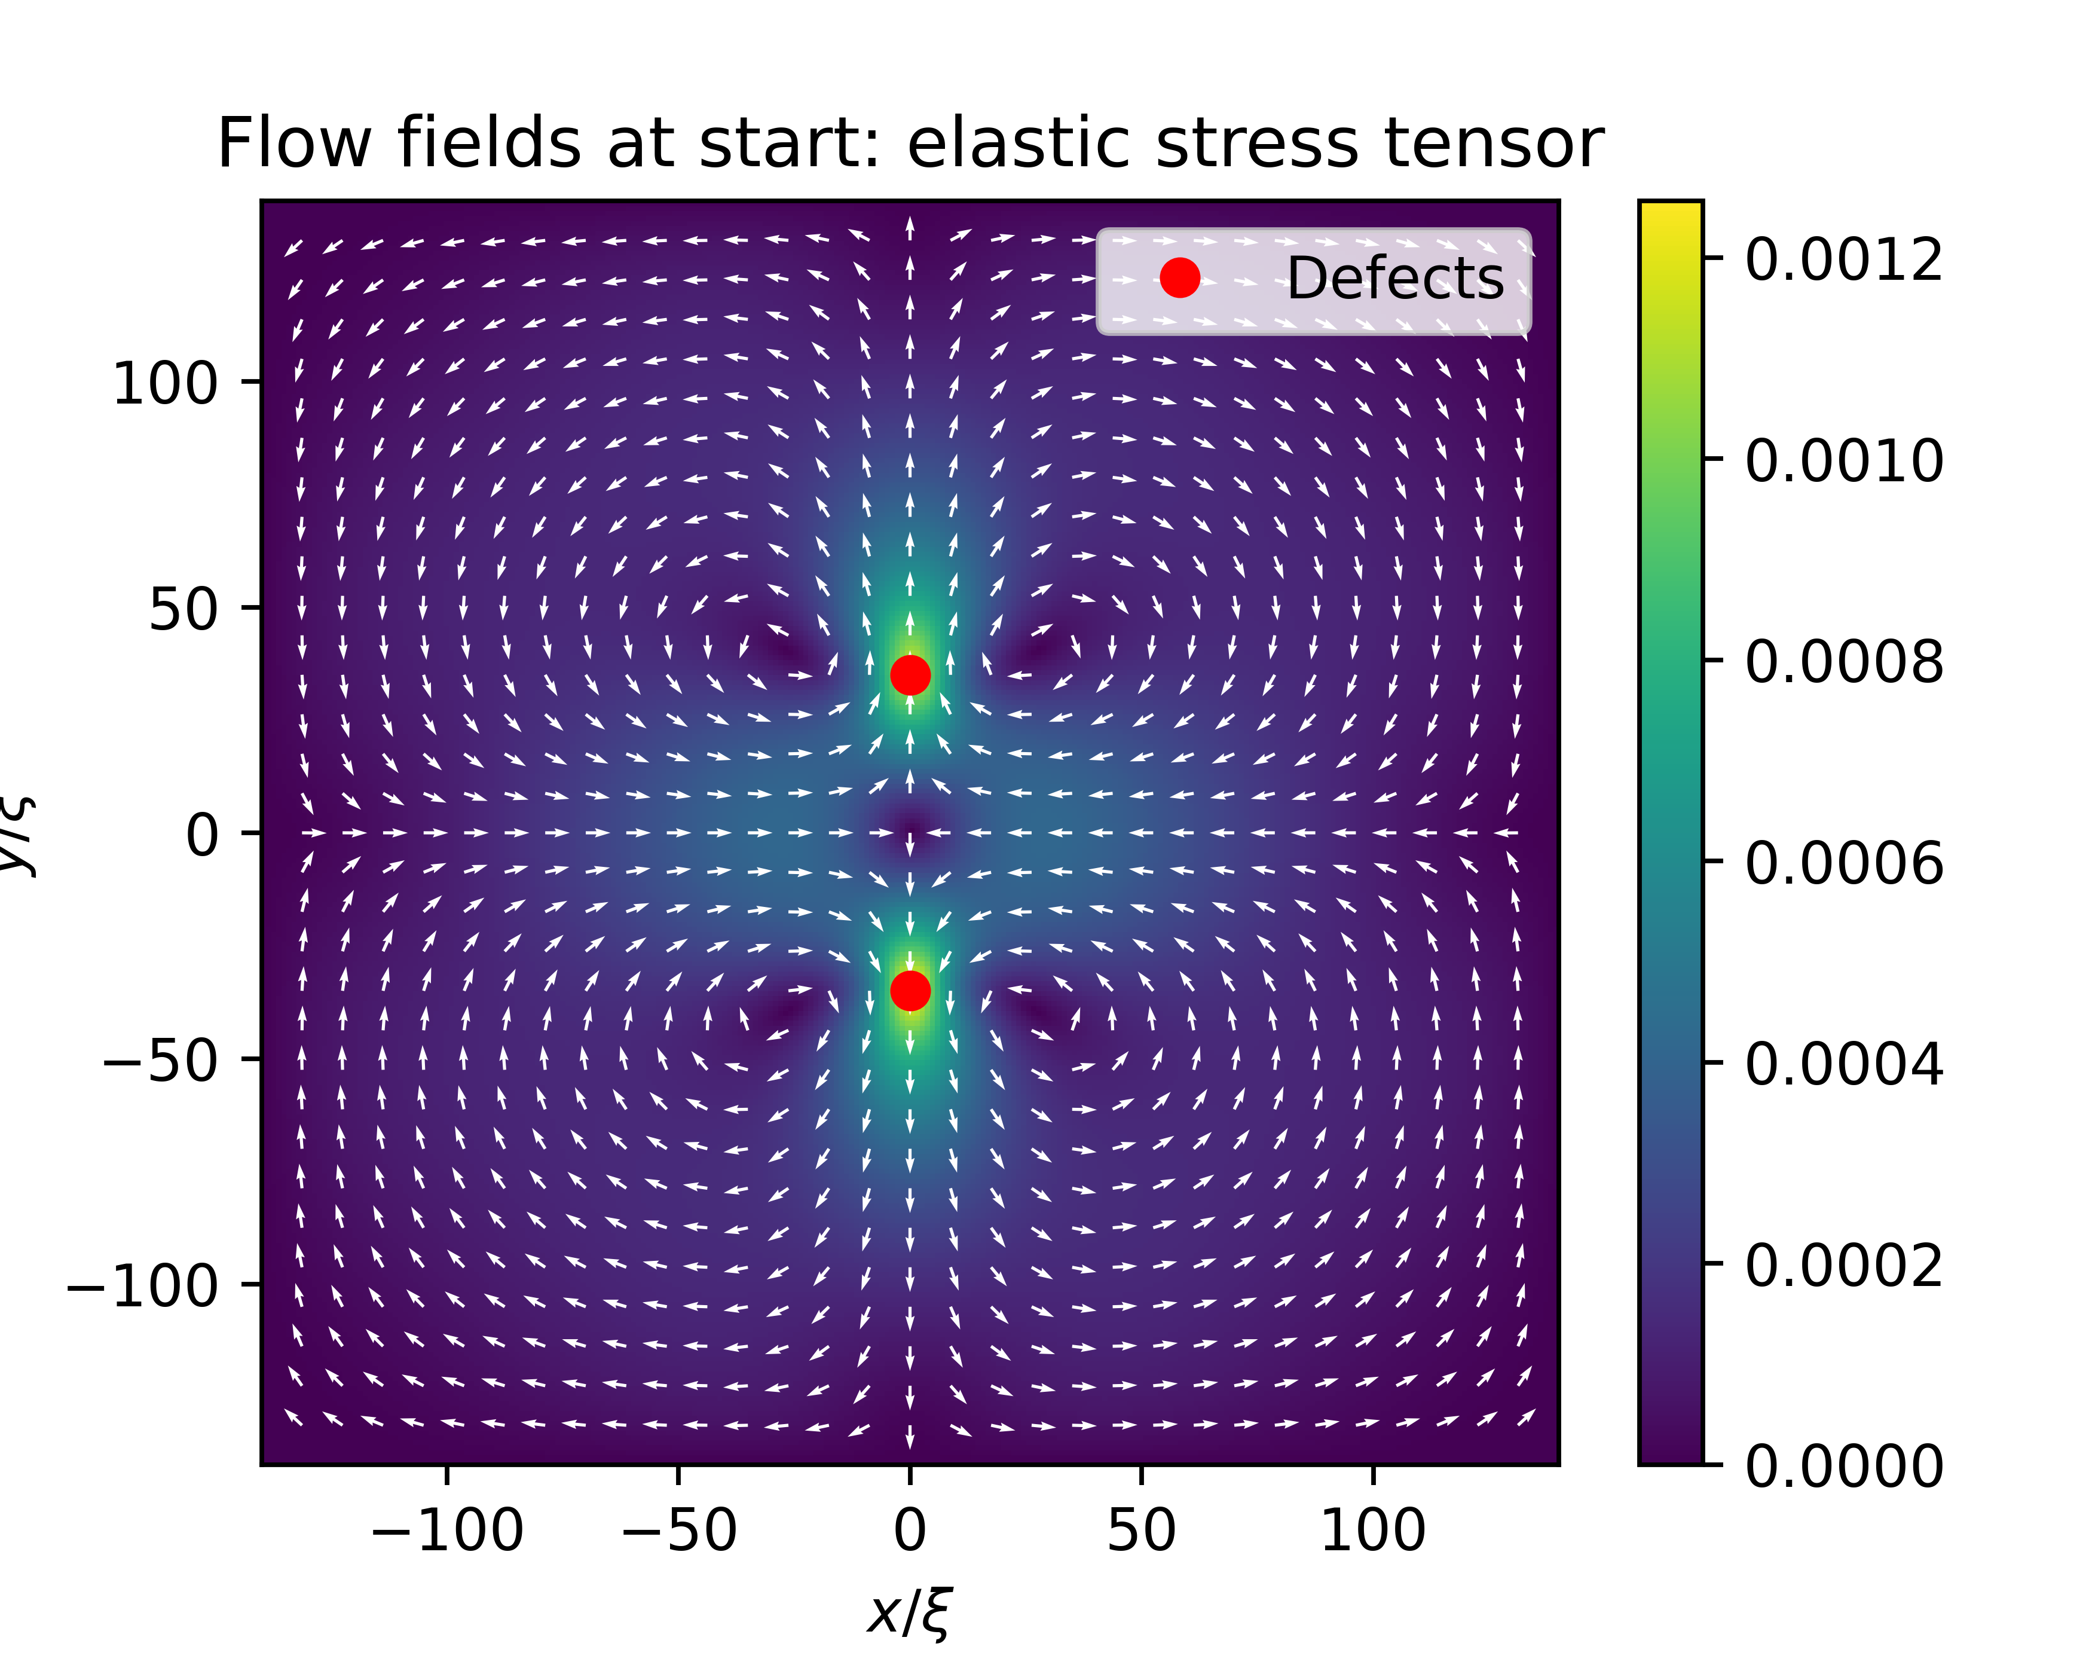
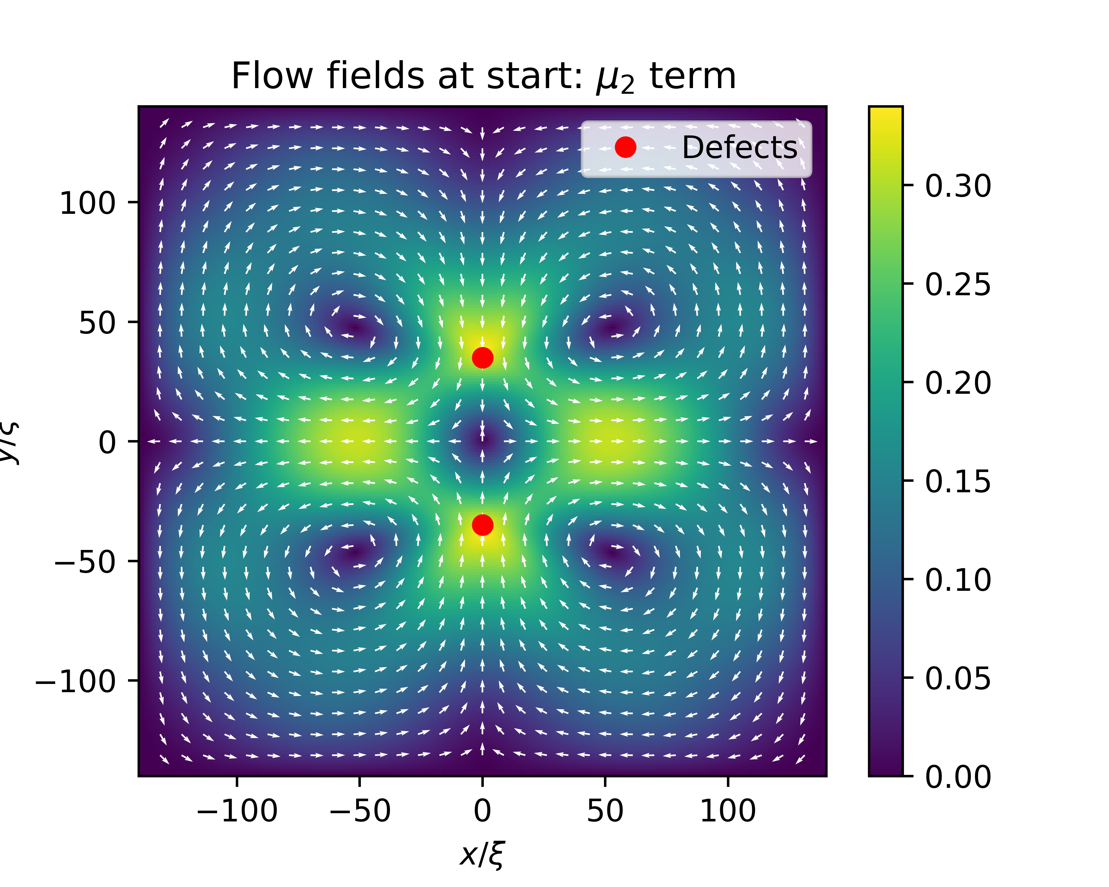
Notes:
It looks like, in all these plots, my elastic stress tensor term is orders of magnitude smaller than their elastic stress tensor term.

Slide 8
513x513 Grid

Slide 9
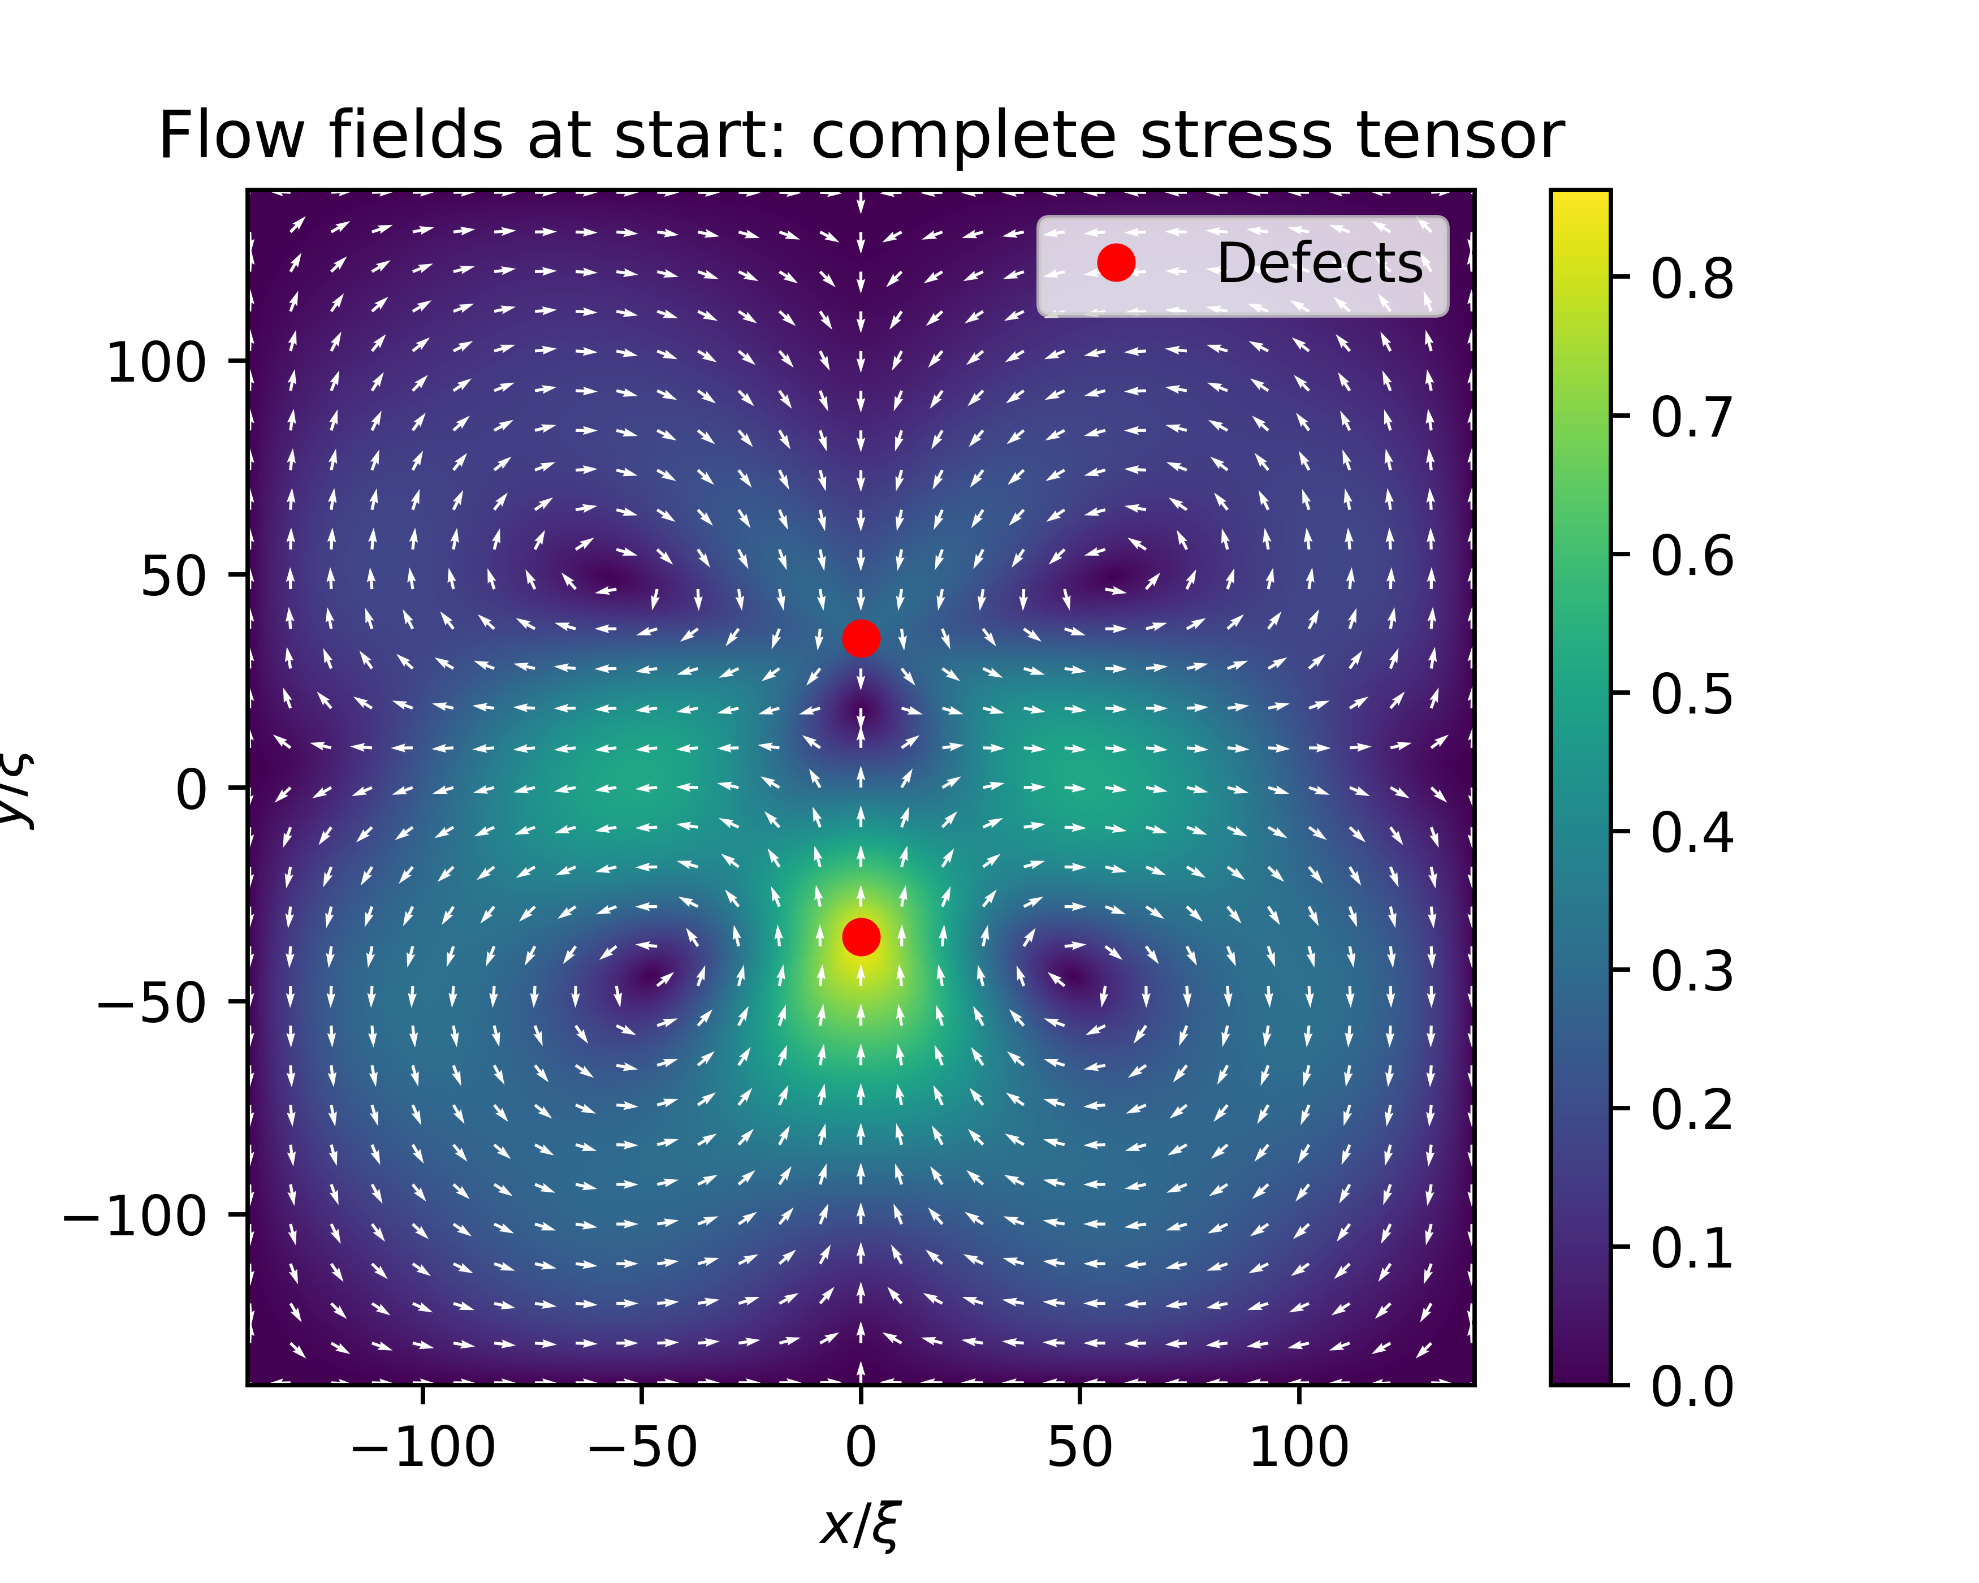


Notes:
As I increased the resolution, it looked like the maximal flow velocity increased as well.

Slide 11
1025x1025 Grid

Slide 12
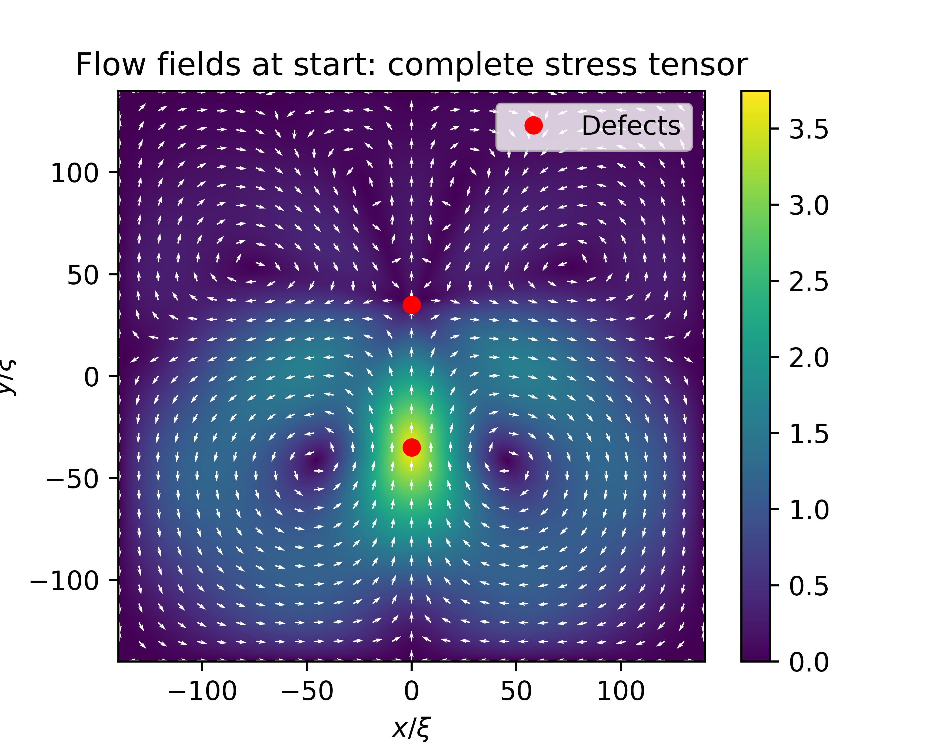
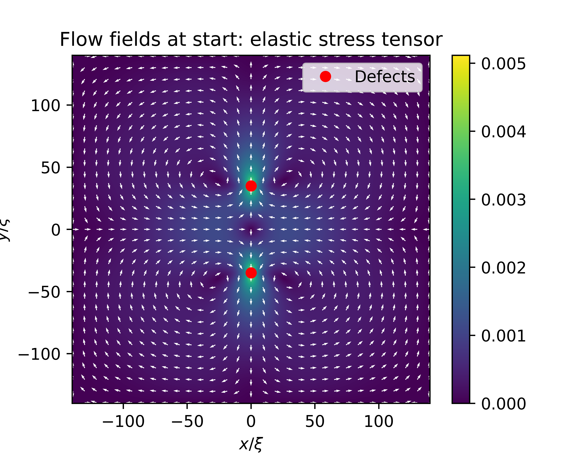
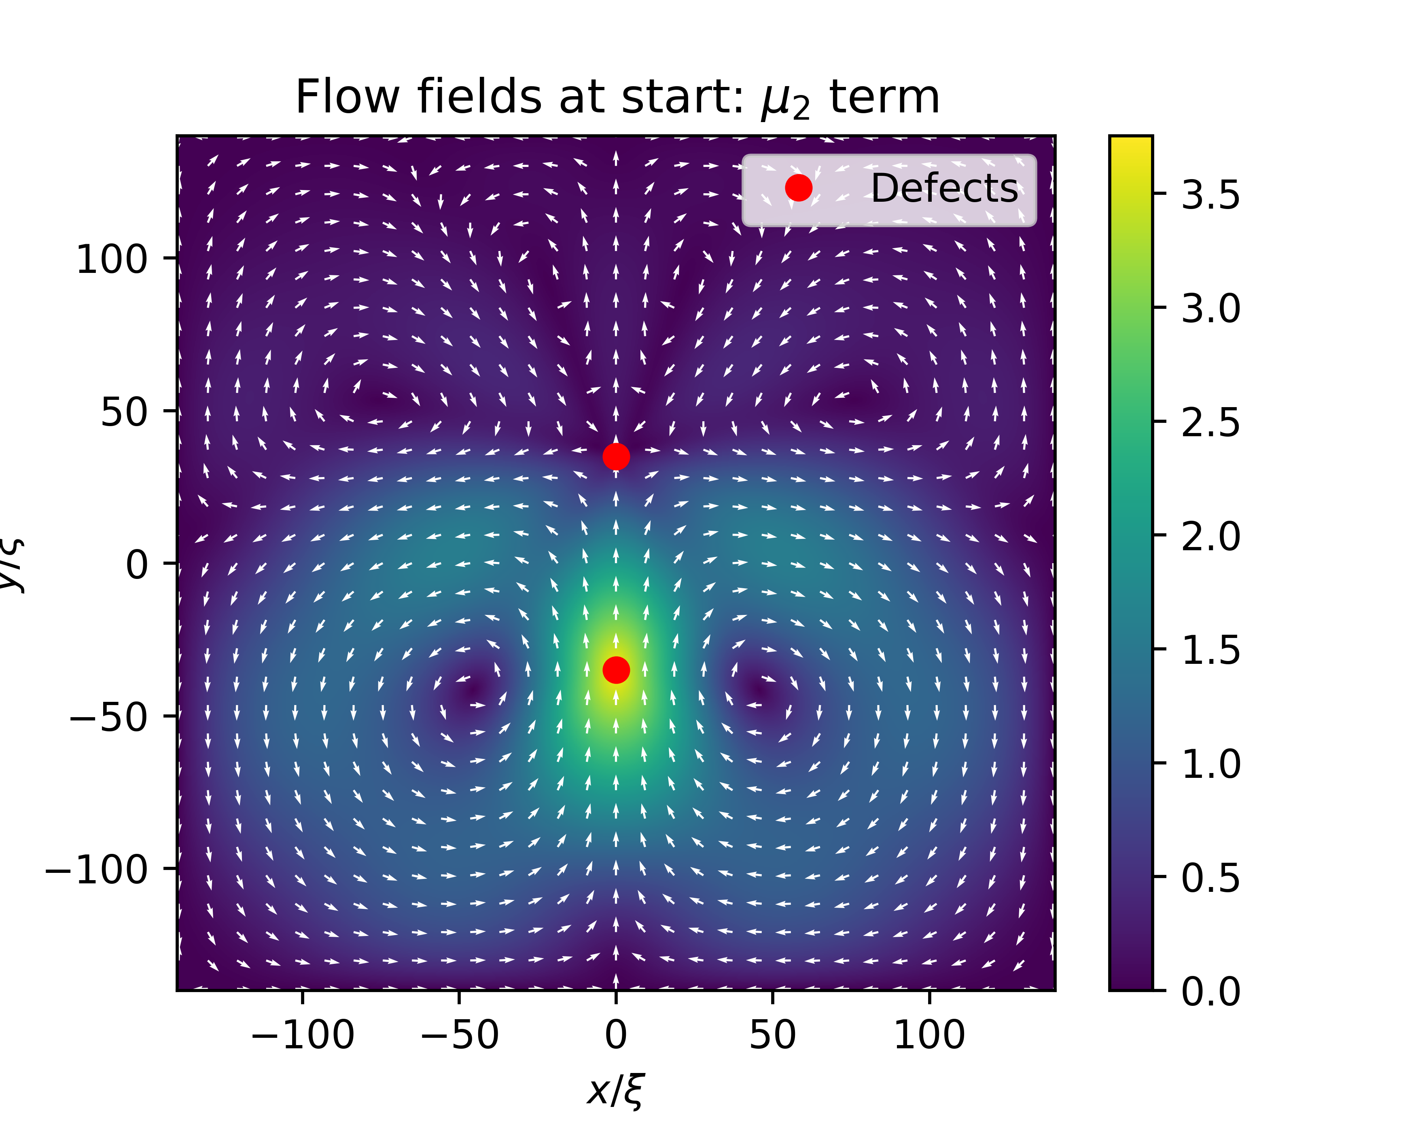
Notes:
Here the flow between the two defects is different than in the lower resolutions: here it goes all the way through, whereas in the other images they met in the middle.

